Slide 1
ANALYZING READABILITY ISSUES IN
AN INFOGRAPHIC WEBPAGE
(TEAM E)
Aditya Mandhare
Dharmendra Vaghela
Rohit Mandge
Rupaj Soni

Slide 2
INTRODUCTION
Analyze the problems faced by users while reading an infographic web page
Articles over the internet are replete with image references and tabular data.
In this project we try to explore reading issues, especially with “out of sync” image references on the webpage.

Slide 3
PROBLEM STATEMENT
Web page contains images and references to these images are made at multiple places across the page
Reader has to scroll back and forth through the web page every time he has to refer to an image
Problems:
Loss of comprehension, continuity, context
Stress on user’s vision
Consumes considerable amount of time
Goal: Extract the source web pages and enhance them to increase visual comprehension

Slide 4
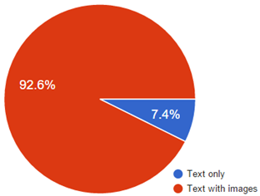
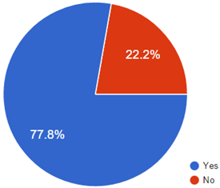
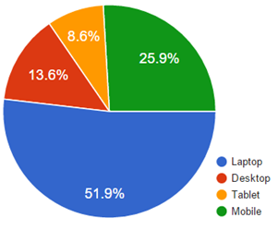
SURVEYS AND RESULTS
Which kind of articles do you prefer to read?
Do you lose context while navigating?
Which device do you use to read web articles?

Slide 5
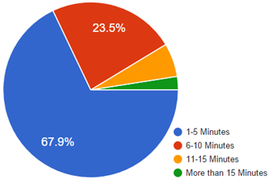
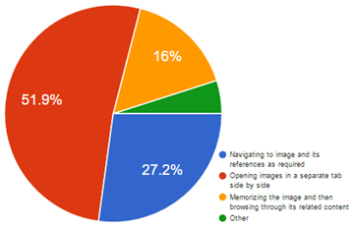
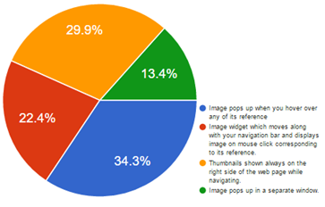
SURVEYS AND RESULTS
Approximately how much time is wasted in scrolling?
How do you deal with scrolling problem?
Which of the proposed methods do you prefer?

Slide 6
Proposed Solutions
Open image in a new tab
Image popup on hover
An image SideBar

Slide 7
Solution 3: Open image in a new tab
What it does?
Identifies occurrences of image reference
Matches pattern to convert to hyperlink
Image opens in a new tab on click
Usability Testing: Observations
Pattern matching
Image opening in a new window

Slide 8
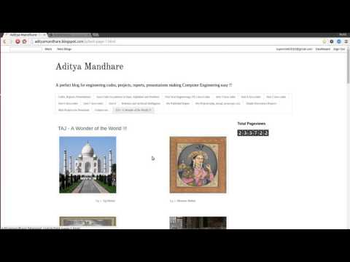
Solution 3: Open image in a new tab

Slide 9
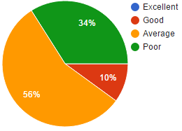
Solution 3: Open image in a new tab
User Rating After Improvements
Why use this?
Webpage remains intact
Original sized image

Slide 10
Solution 2: Image popup on hover
What it does?
Identifies plaintext references in the page
Converts references to hyperlinks
Image pops up on hover over hyperlink
Usability Testing: Observations
Inline image replacement Vs Image popup
Text disorientation
Pattern matching
Image flickering

Slide 11
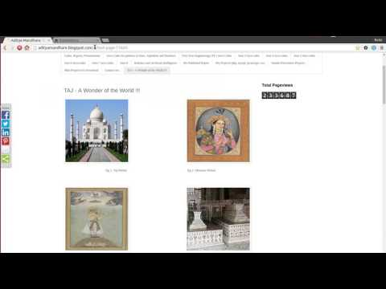
Solution 2: Image popup on hover

Slide 12
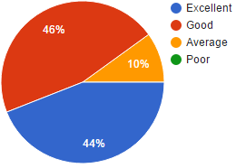
Solution 2: Image popup on hover
User Rating After Improvements
Why use this?
Simple, intuitive and clean
Webpage remains intact
User doesn’t lose context

Slide 13
Solution 1: An image SideBar
What it does?
Identifies all the images in the webpage
Group them together in a sidebar
Hover over → Move to image position
Hover away → Back to original position
Usability Testing: Observations
Sidebar positioning and Preview Image Size
Navigation method
Valid image extraction
Dismiss feature

Slide 14
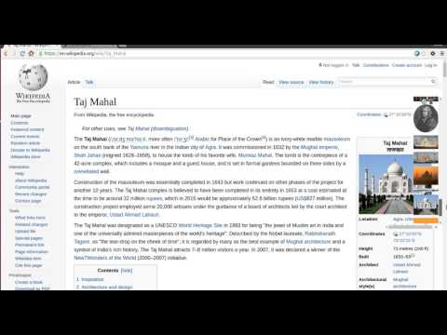
Solution 1: An image SideBar

Slide 15
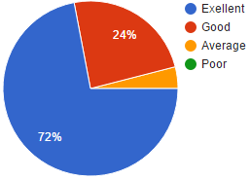
Solution 1: An image SideBar
User Rating After Improvements
Why use this?
Independent of web page structure
Consolidated view of all images
Reading continuity is maintained

Slide 16
And the winner is...

Slide 17
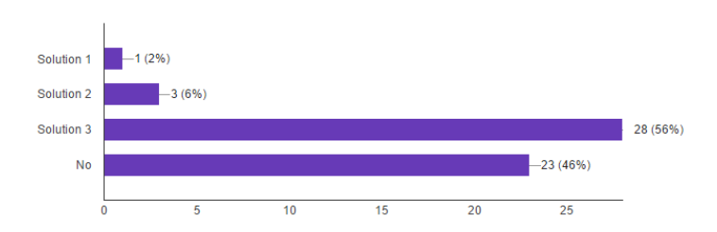
Best Solution: An image SideBar
Usability testing and Acceptance testing result in favor of Sidebar
Concise view of all images in a sidebar
Image can be referred from the original position without losing context
Whether users lost context?

Slide 18
QUESTIONS??

